Slide 1
Welcome To the world of data science
Let's study an interesting topic in data science
EDA

Slide 2
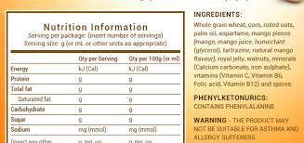
When we buy some packaged food items, we check its components, manufacturing date, expiry data, weight details but why? We do it to know what we are consuming, to know our food item, what it can result in…… It is known as EDA(Exploratory data analysis.)

Slide 3
Exploratory Data Analysis
What is EDA?
It is an approach that is used to analyze the data and discover trends, patterns, or check assumptions in data with the help of statistical summaries and graphical representations.
It is used for gaining a better understanding of data aspects like:
– main features of data
– variables and relationships that hold between them
– identifying which variables are important for our problem

Slide 4
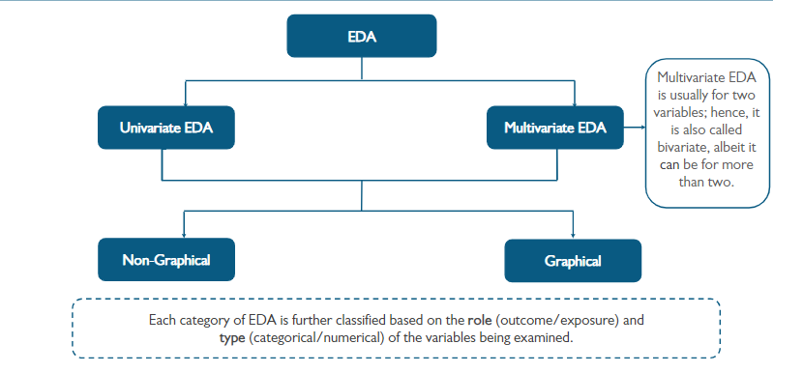
Types of EDA

Slide 5
Steps to perform EDA
1. Data Collection: Gather the data from various sources, such as databases, files, APIs, or web scraping. Ensure that the data is in a format suitable for analysis.
2. Data Inspection: Take an initial look at the data to understand its structure and format. Check the first few rows, variable names, data types, and general statistics.
3. Data Cleaning: Cleanse the data to handle missing values, duplicates, and outliers. Impute missing data or decide on an appropriate strategy for dealing with them. Remove any duplicate records that might skew the analysis. Handle outliers by either removing them or transforming their values.
4. Data Visualization: Use data visualization techniques to represent the data graphically. Create plots such as histograms, scatter plots, box plots, bar charts, heatmaps, etc., to explore the distribution of data, identify patterns, and detect anomalies.
5. Data Transformation: If necessary, perform data transformations such as log transformations, scaling, or normalization to make the data suitable for analysis.

Slide 6
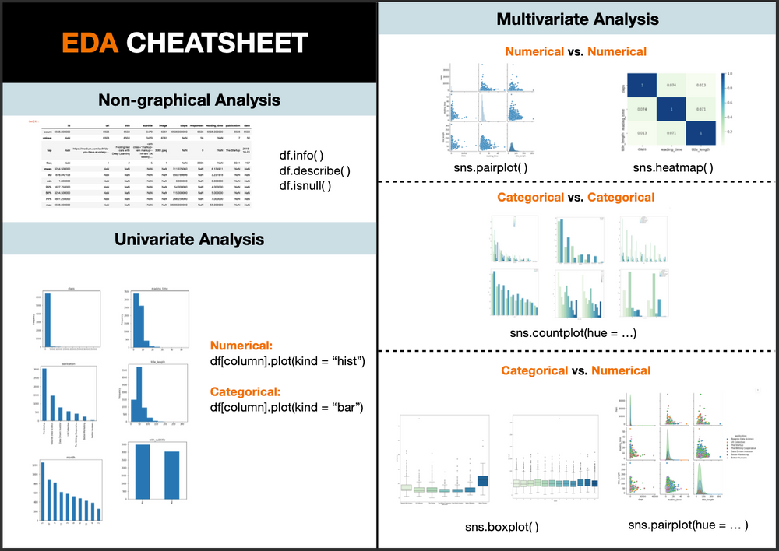
Implementation of EDA
EDA can be performed using python or R language.

Slide 7

Thankyou
Open for your questions….

